Slide 1
Train and optimise your models with Automated ML
Delon Yau
Software Engineer
Commercial Software Engineering
Microsoft Asia

Slide 2
Azure ML SDK
Released in public preview at Ignite 2018
GA = Dec 2018
Series of python packages
Main one is azureml-sdk
Simple pip install
Extensions for Jupyter notebooks, AutoML, hyperparam tuning etc
Can do everything through code including -
Resource provisioning and management
Great for automation / one button deployment
Experimentation, model registry, deployment etc

Slide 3
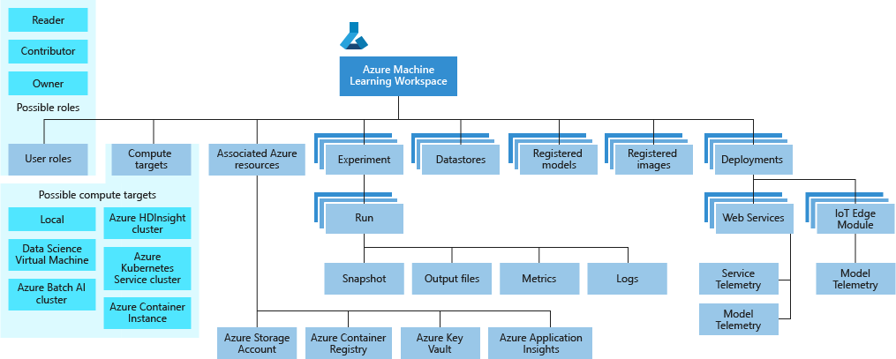
Core concept: Workspace

Slide 4
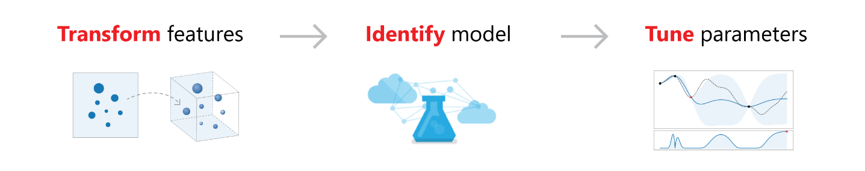
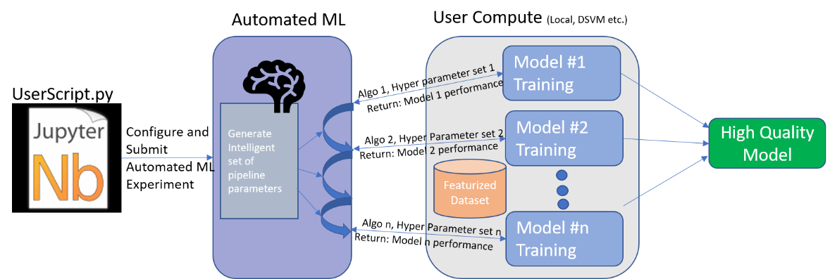
Azure ML Features
Automated Machine Learning
Should I transform input data, and if so, how – by removing nulls, rescaling, or something else?
What ML algorithm would be best – an SVM, logistic regression, or a tree-based classifier?
What parameter values to choose – e.g., what the max depth and min split count should be for a tree-based classifier?
And this process repeats …
a series of sequential, interconnected decisions

Slide 5
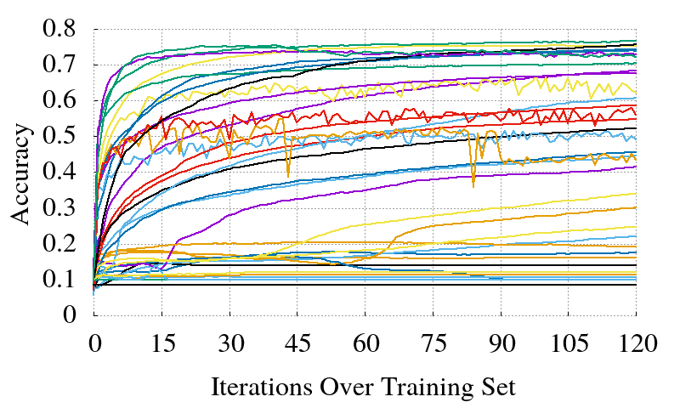
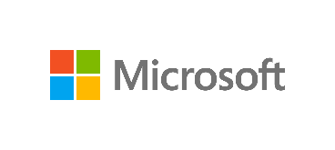
Hyperparameters
Adjustable parameters chosen prior to training a model, that govern the training process
e.g. number / size of hidden layers, learning rate, batch size, etc
ML / DL model performance depends heavily on hyperparameter selection
Notes:
Not to be confused with model weights that change during the training process

Slide 6
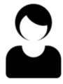
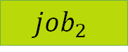
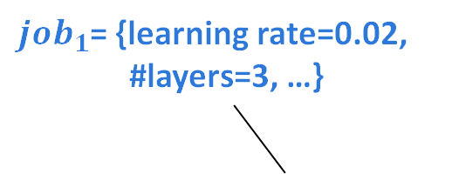
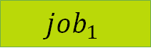
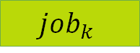
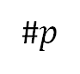

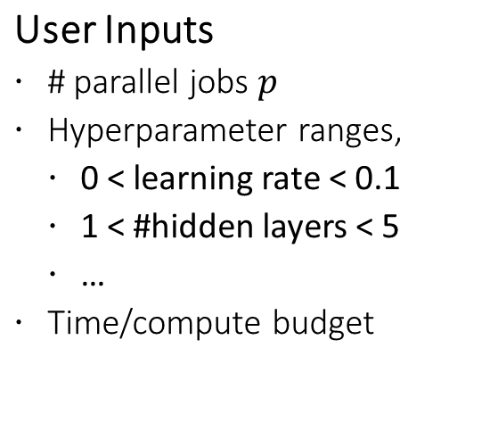
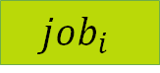

HyperDrive Overview
HyperDrive
User Inputs
# parallel jobs $p$
Hyperparameter ranges,
0 < learning rate < 0.1
1 < #hidden layers < 5
…
Time/compute budget
(A) Generate new jobs
Configuration choice?
${job}_{1}$= {learning rate=0.02,
#layers=3, …}
#1
$${job}_{1}$$
$${job}_{i}$$
???
#2
$${job}_{2}$$
$${job}_{j}$$
…
#$p$
$${job}_{p}$$
$${job}_{k}$$
Time
(B) Manage active jobs
How long to run a job?
How much resource usage?
Recommended configurations, metrics & job outputs

Slide 7
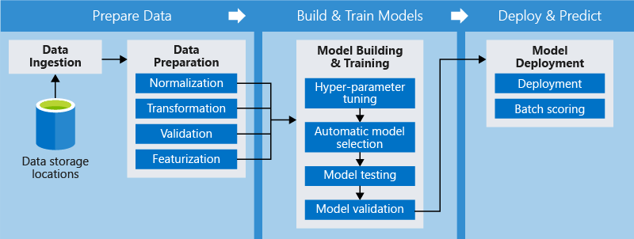
ML Pipelines and Azure Machine Learning

Slide 8
Azure Machine Learning Operationalization
Ease of Discovery: Find the right model for your needs
Ease of deployment: Deploy the model easily
Reach of Deployment: Deploy the model anywhere
Ease of Integration: Use the tools you are familiar with to create AI apps and manage them
Single pane of glass for monitoring and management: All your AI models in one place

Slide 9
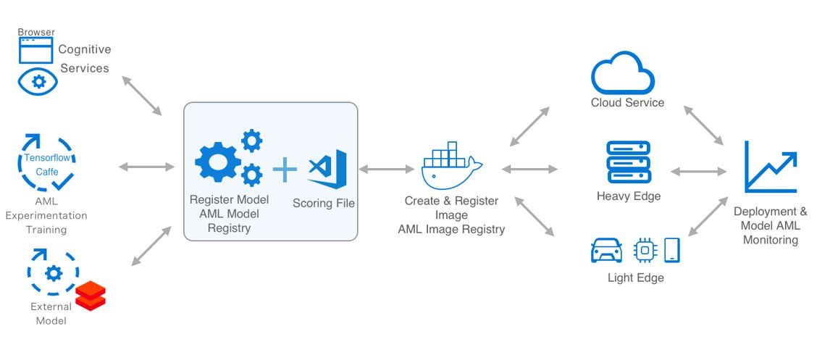
Azure ML operationalization
ACI, AKS – can reuse image, add https
+ dependencies
Local
GPU
Batch AI
AutoML
Hyperdrive
Versioned
models
init()
run()
Customizable image
App insights –
Monitoring: failures, performance etc
Logging: Model inputs, predictions, custom logging
Automatic scaling of service based on load
Model can come from anywhere (Aether, research paper, local training etc)

Slide 10


Microsoft Hardware Acceleration
Edge
Cloud
CPUs
GPUs
FPGAs
ASICs
FLEXIBILITY
EFFICIENCY
TRAINING CPUs and GPUs
INFERENCING CPUs, GPUS, FPGAs
TRAINING
(HEAVY EDGE) CPUs and GPUs
INFERENCING CPUs, GPUS, FPGAs, ASICs

Slide 11
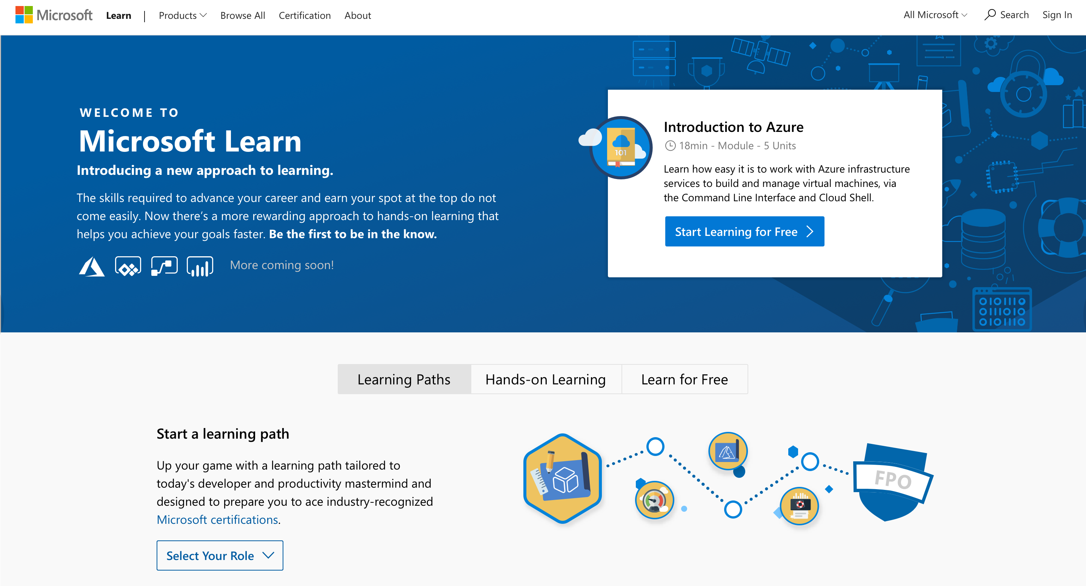
Microsoft Learn
Free, quick, and role-based
hands-on trainings
aka.ms/mslearnevent
Notes:
Key point: MS Learn is a technical learning platform recently launched at Ignite 2018.

Slide 12
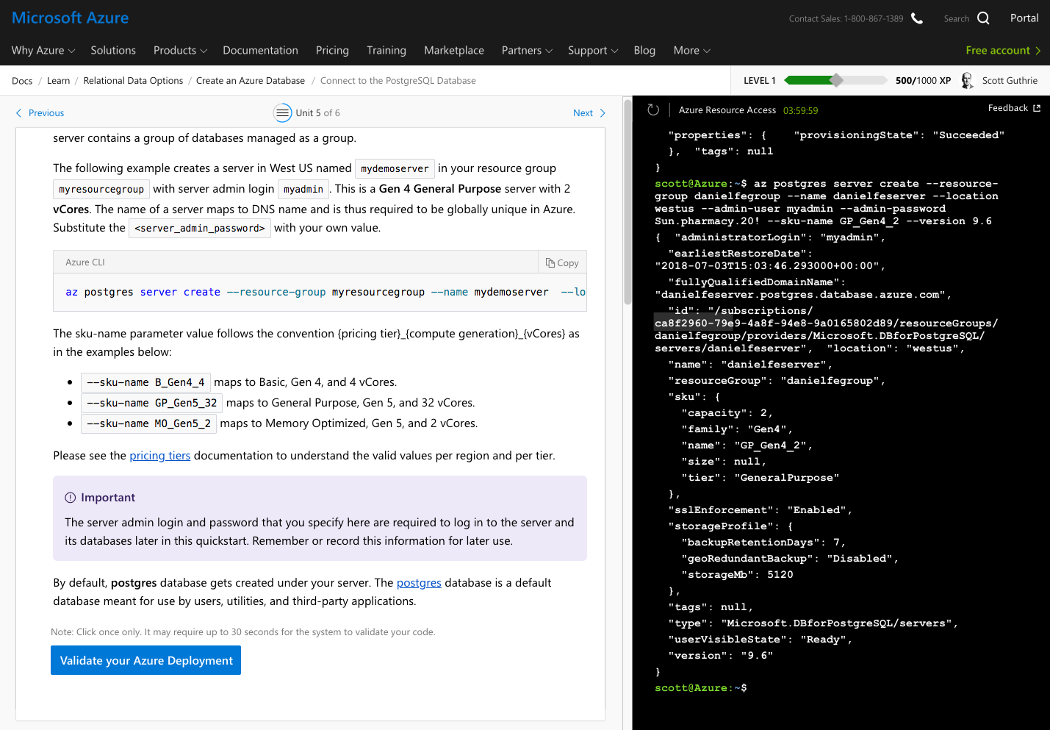
No-install,
browser-based scripting environment
to try Azure
Notes:
No-install, browser-based scripting environment.
Validates learning and skills through task validation in the Azure environment.

Slide 13
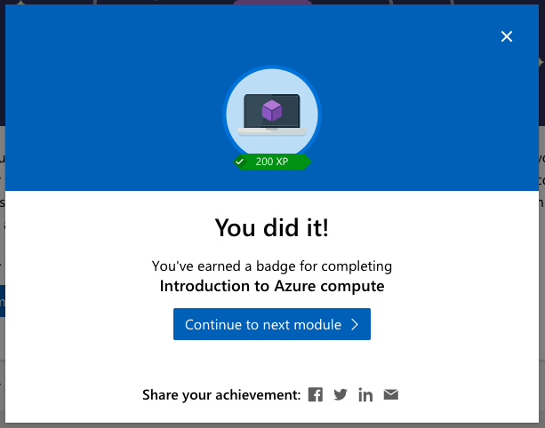
Level Up and Earn Achievements
Notes:
Accurate completion unlocks achievement and allows learner to move on to the next step.

Slide 14

Create neural networks with TensorFlow on the Azure Data Science Virtual Machine

Slide 15

Interactive deep learning with Jupyter, Docker and PyTorch on the Data Science Virtual Machine

Slide 16
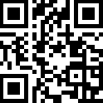
Earn a badge on Microsoft Learn for a free gift
Come to our booth to learn more!
aka.ms/mslearnevent
Notes:
We will have a booth outside at PyCon to introduce MS Learn, and help them set up an account. People who earn a badge on MS Learn can set the screenshot to mslearnhk@outlook.com, we will send them a box of dev swag (t shirt, stickers, pins, premium etc☺)

